Slide 1
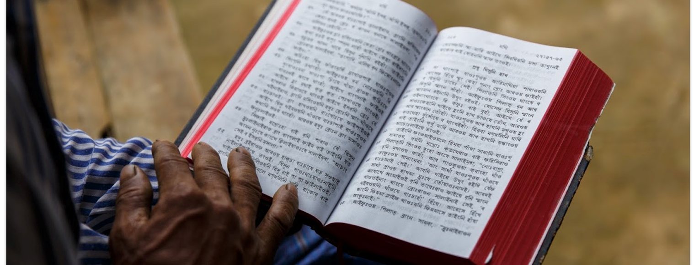
Open Copyright License
You shall not steal, nor deal falsely, nor lie to one another (Lev. 19:11).
All Scripture is taken from the New King James Version®. © 1982 by Thomas Nelson, Inc. Used by permission. All rights reserved.
CC BY-SA

Slide 2
?
© Copyright

Slide 3
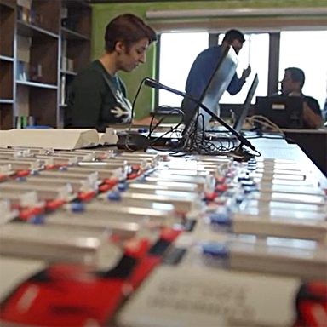
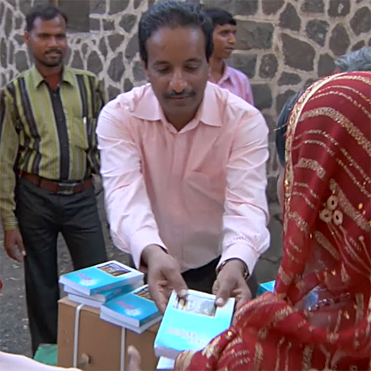
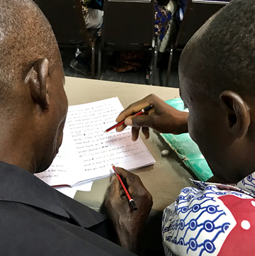
Copyright or “All Rights Reserved”
Without additional permission, others cannot:
Make copies
Distribute copies
Make changes
Getting permission can be a lengthy and costly process.

Slide 4



Gives permission without being asked.
Creative
Commons
Share
Alike
Attribution
Everyone has rights to copy, change and distribute…
…if credit is given to the creator…
…and any new work based on the original must use the CC BY-SA License also.
Slide adapted from https://docs.google.com/presentation/d/1xRsF5LrTSGzrQ6o4fW9xemthraKJ4IKLpfNBaDh5QkA/edit#slide=id.p and https://creativecommons.org/ site.

Slide 5
?
Why do you think that WA uses Creative Commons
instead of Copyright?
“…Freely you have received, freely give.”
Matthew 10:8b

Slide 6



With CC BY-SA license
Permission is granted in advance to:
Make copies
Distribute copies
Make changes
You Must:
Give attribution.
Share alike.

